Slide 2

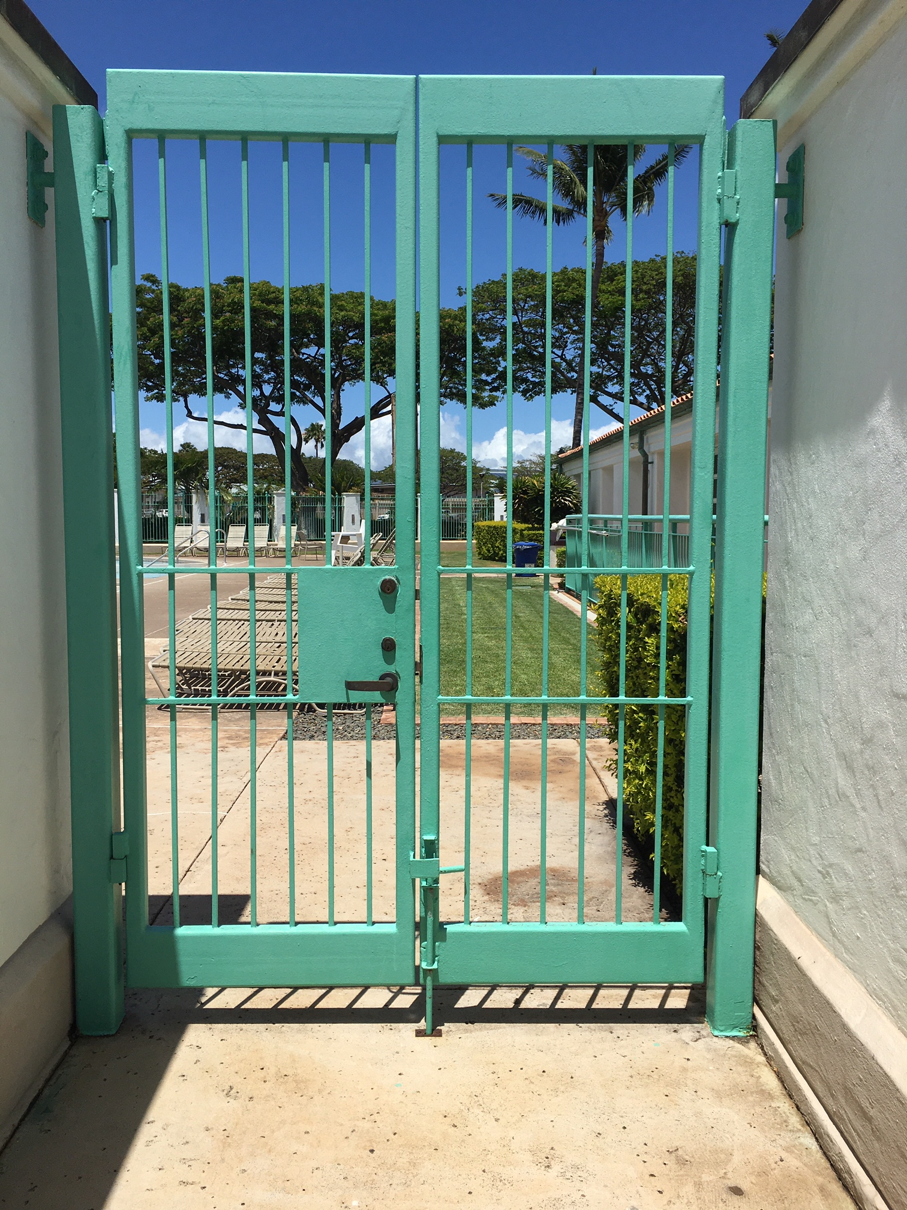

Villages of Kapolei Association
orange
237, 125, 49
#ED7D31
yellow
246, 214, 91
#F6D65B
red
211, 75, 27
#D34B1B
teal
114, 180, 172
#72B4AC
green
1, 127, 27
#017F1B
blue
0, 110, 147
#006E93

Slide 3

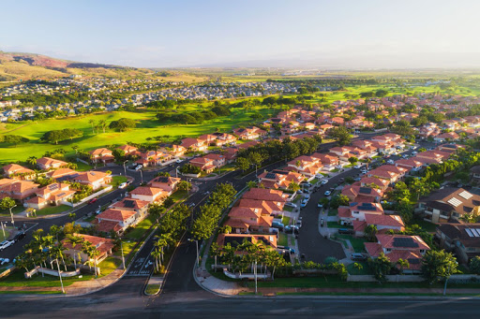
Villages of Kapolei Association
Payment
Contact
Search
Residents HOA Dues Events News About Us
Kauhale (Home)
Ohana (Family)
Kaiaulu (Community)

Slide 4
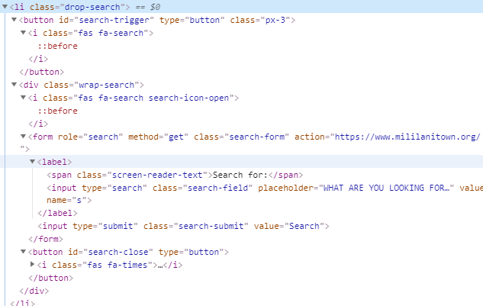
Villages of Kapolei Association
Payment
Contact
Search
Residents HOA Dues Events News About Us

